Slide 1
Electric Circuits
Physics Unit 9
Notes:
Physics Unit 9

Slide 2
This Slideshow was developed to accompany the textbook
  OpenStax Physics
    Available for free at https://openstaxcollege.org/textbooks/college-physics
  By OpenStax College and Rice University
  2013 edition
Some examples and diagrams are taken from the textbook.
Slides created by
Richard Wright, Andrews Academy
rwright@andrews.edu

Slide 3
09-01 Current, Resistance, and Ohm’s Law
In this lesson you will…
• Define electric current and ampere
• Describe the direction of charge flow in conventional current.
• Explain the origin of Ohm’s law.
• Calculate voltages, currents, or resistances with Ohm’s law.
• Describe a simple circuit.

Slide 4

09-01 Current, Resistance, and Ohm’s Law
Current
Rate of flow of charge
  Amount of charge per unit time that crosses one point
$$I=\frac{ΔQ}{Δt}$$
Symbol: (I)
Unit: ampere (A)

Slide 5

09-01 Current, Resistance, and Ohm’s Law
Small computer speakers often have power supplies that give 12 VDC at 200 mA. How much charge flows through the circuit in 1 hour and how much energy is used to deliver this charge?
$ΔQ$ = 720 C
E = 8640 J
Notes:
Charge in 1 hour:
$$I=ΔQ/Δt → ΔQ=IΔt=\left(.2 A\right)\left(3600 s\right)=720 C$$
Energy:
$$EPE=qV=\left(720 C\right)12 V=8640 J$$
The speakers usually don’t draw that much current. They only draw that much current at their maximum volume.

Slide 6
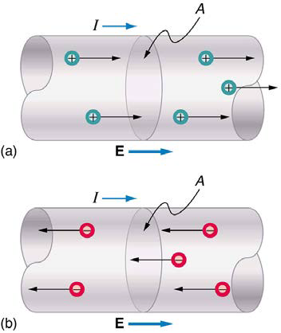
09-01 Current, Resistance, and Ohm’s Law
Conventional Current
Electrons are the charge that flows through wires
Historically thought positive charges move
Conventional current → imaginary flow of positive charges
  Flows from positive terminal and into negative terminal
  Real current flows the opposite way

Slide 7
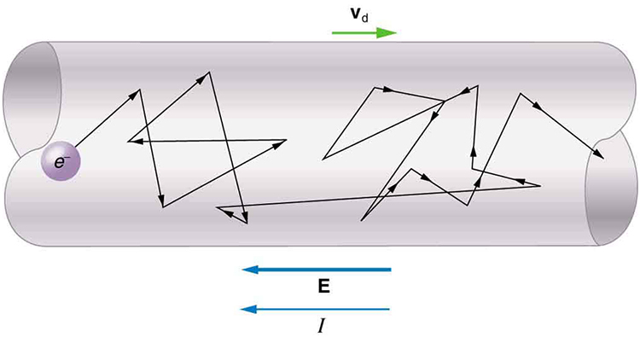
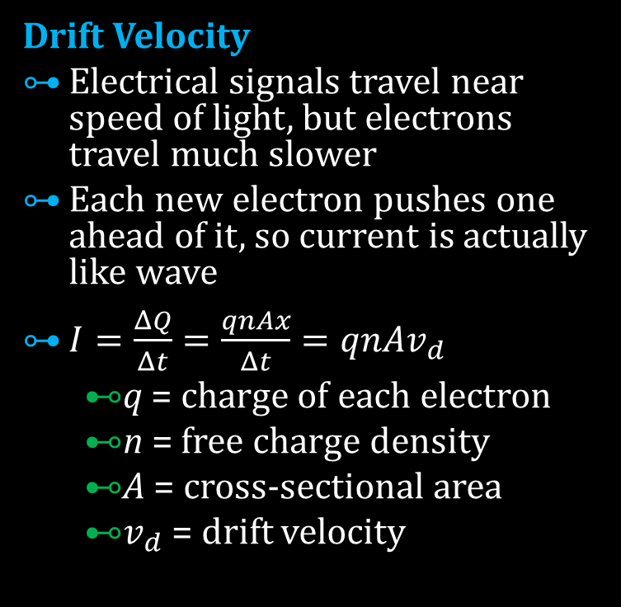
09-01 Current, Resistance, and Ohm’s Law
Drift Velocity
Electrical signals travel near speed of light, but electrons travel much slower
Each new electron pushes one ahead of it, so current is actually like wave
$I=\frac{ΔQ}{Δt}=\frac{qnAx}{Δt}=qnAv_{d}$
  q = charge of each electron
  n = free charge density
  A = cross-sectional area
  $v_{d}$ = drift velocity

Slide 8
09-01 Current, Resistance, and Ohm’s Law
Think of water pumps
  Bigger pumps → more water flowing
  Skinny pipes (more resistance) → less water flow
Electrical Circuits
  Bigger battery voltage → more current
  Big electrical resistance → less current

Slide 9
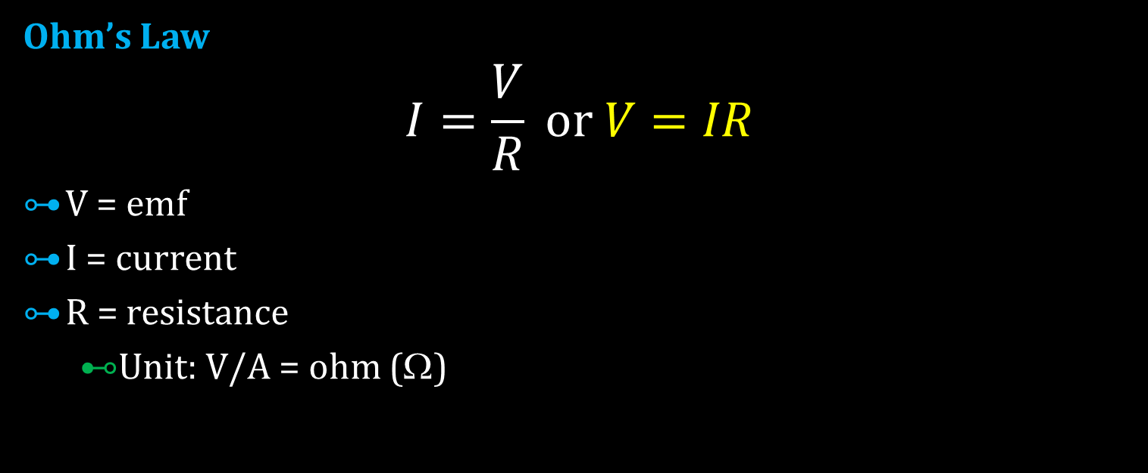
09-01 Current, Resistance, and Ohm’s Law
Ohm’s Law
$$I=\frac{V}{R} or V=IR$$
V = emf
I = current
R = resistance
  Unit: V/A = ohm (Ω)

Slide 10
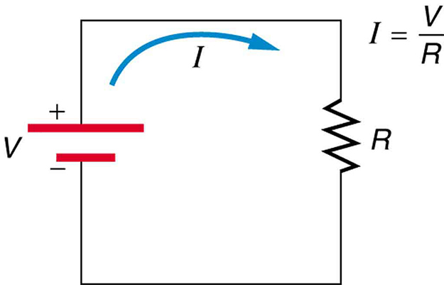
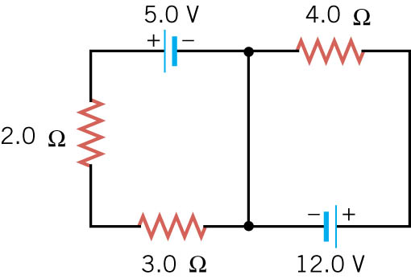
09-01 Current, Resistance, and Ohm’s Law
Resistors
Device that offers resistance to flow of charges
Copper wire has very little resistance
Symbols used for
  Resistor →
  Wire →

Slide 11

09-01 Current, Resistance, and Ohm’s Law
Our speakers use 200 mA of current at maximum volume. The voltage is 12V. The current is used to produce a magnet which is used to move the speaker cone. Find the resistance of the electromagnet.
R = 60 $Ω$
Notes:
$$V=IR→12 V=\left(0.20 A\right)R→60 Ω=R$$

Slide 12
09-01 Homework
Hopefully these circuit problems won’t have you running around in circles
Read 20.3

Slide 13
09-02 Resistance and Resistivity
In this lesson you will…
• Explain the concept of resistivity.
• Use resistivity to calculate the resistance of specified configurations of material.
• Use the thermal coefficient of resistivity to calculate the change of resistance with temperature.

Slide 14
09-02 Resistance and Resistivity
Another way to find resistance
The resistance varies directly with length and inversely with width (or cross-sectional area) a wire
  Kind of like trying to get a lot of water through a pipe
Short, thick wire → small resistance
Long, skinny wire → large resistance

Slide 15

09-02 Resistance and Resistivity
$$R=\frac{ρL}{A}$$
$ρ$ = resistivity
  Unit: Ω m
Table 20.1 lists resistivities of some materials
  Metals → small resistivity (1x10⁻⁸ Ω m)
  Insulators → large resisitivity (1x10¹⁵ Ω m)
  Semi-conductors → medium resistivity

Slide 16
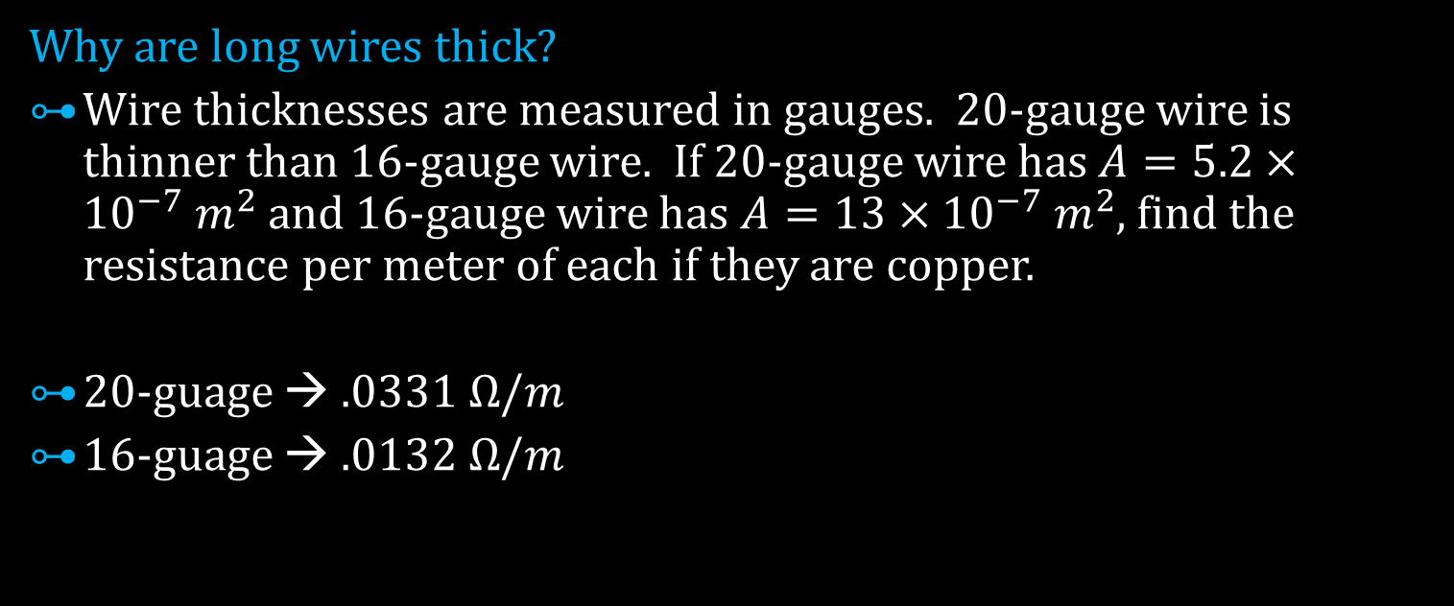
09-02 Resistance and Resistivity
Why are long wires thick?
Wire thicknesses are measured in gauges. 20-gauge wire is thinner than 16-gauge wire. If 20-gauge wire has $A=5.2×{10}^{−7} m^{2}$ and 16-gauge wire has $A=13×{10}^{−7} m^{2}$, find the resistance per meter of each if they are copper.
20-guage → $.0331 Ω/m$
16-guage → $.0132 Ω/m$
Notes:
$$R=\frac{ρL}{A} →\frac{R}{L}=\frac{ρ}{A}$$
$$ρ=1.72×{10}^{−8} Ωm$$
$$20−gauge:$$
$$\frac{R}{L}=\frac{1.72×{10}^{−8} Ωm}{5.2×{10}^{−7} m^{2}}=0.033 Ω/m$$
$$16−gauge:$$
$$\frac{R}{L}=\frac{1.72×{10}^{−8} Ωm}{13×{10}^{−7} m^{2}}=0.013 Ω/m$$
$$20−gauge has about 3 times the resistance$$

Slide 17

09-02 Resistance and Resistivity
Resistivity and Temperature
$$ρ=ρ_{0}\left(1+αΔT\right)$$
$ρ$ = resistivity at temperature T
$ρ_{0}$ = resistivity at temperature T₀
$α$ = temperature coefficient of resistivity
  Unit: 1/°C (or 1/K)

Slide 18
09-02 Resistance and Resistivity
Metals
  Resistivity increases with temperature
  α is positive
Semiconductors
  Resistivity decreases with temperature
  α is negative

Slide 19
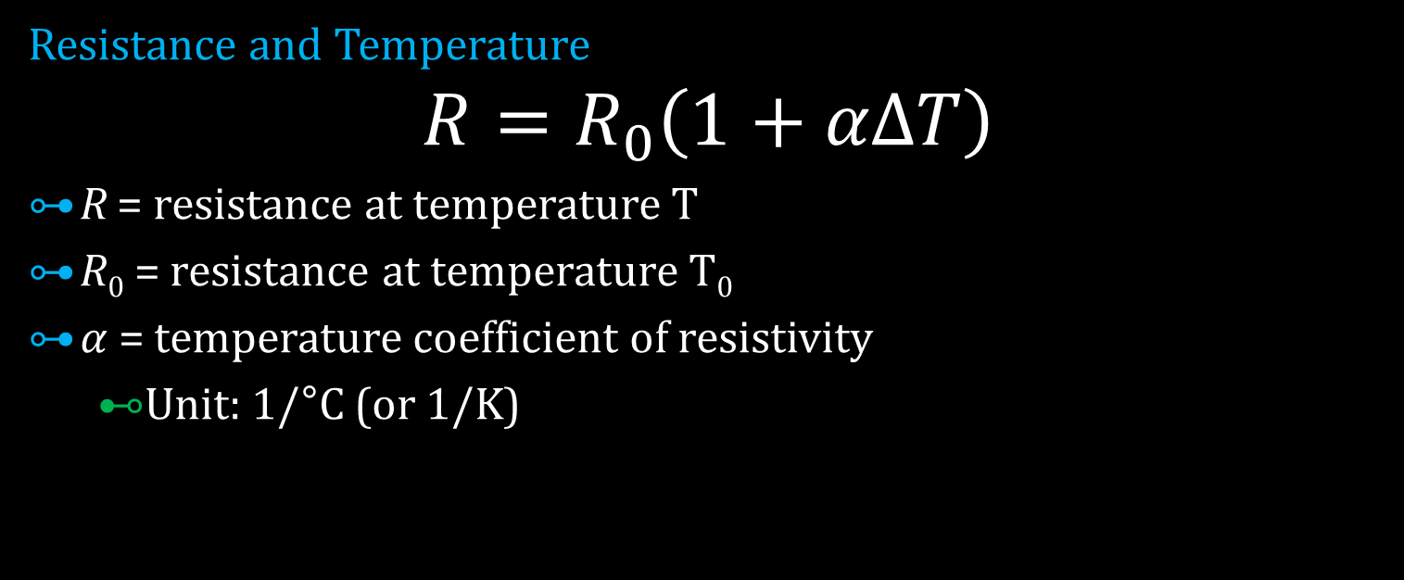
09-02 Resistance and Resistivity
Resistance and Temperature
$$R=R_{0}\left(1+αΔT\right)$$
R = resistance at temperature T
R₀ = resistance at temperature T₀
$α$ = temperature coefficient of resistivity
  Unit: 1/°C (or 1/K)

Slide 20

09-02 Resistance and Resistivity
A heating element is a wire with cross-sectional area of $2×{10}^{−7} m^{2}$ and is 1.3 m long. The material has resistivity of $4×{10}^{−5} Ωm$ at 200°C and a temperature coefficient of $3×{10}^{−2}$ 1/°C. Find the resistance of the element at 350°C.
R = 1430 $Ω$
Notes:
Find new resistivity
$$ρ=\left(4×{10}^{−5} Ωm\right)\left[1+\left(3×{10}^{−2}\frac{1}{°C}\right)\left(350 °C−200 °C\right)\right]=2.2×{10}^{−4} Ωm$$
Find resistance
$$R=\frac{ρL}{A}=\frac{\left(2.2×{10}^{−4} Ωm\right)\left(1.3m\right)}{2×{10}^{−7} m^{2}}=1430 Ω$$

Slide 21
09-02 Resistance and Resistivity
Superconductors
Materials whose resistivity = 0
Metals become superconductors at very low temperatures
Some materials using copper oxide work at much higher temperatures
No current loss
Used in
  Transmission of electricity
  MRI
  Maglev
  Powerful, small electric motors
  Faster computer chips
Notes:
Current in some superconductors have be constant for many years

Slide 22
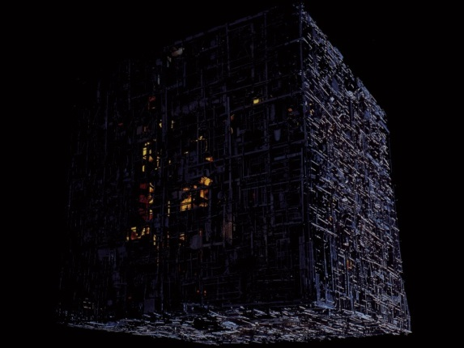
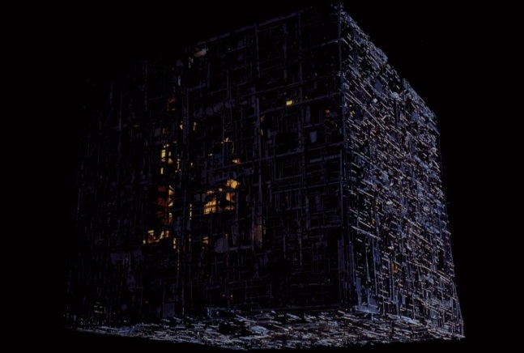
09-02 Homework
Resistance is futile
Read 20.4, 20.5

Slide 23
09-03 Electric Power and AC/DC
In this lesson you will…
• Calculate the power dissipated by a resistor and power supplied by a power supply.
• Calculate the cost of electricity under various circumstances.
• Explain the differences and similarities between AC and DC current.
• Calculate rms voltage, current, and average power.

Slide 24
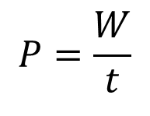
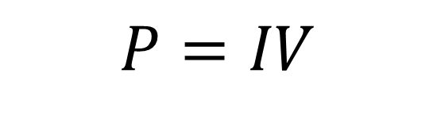
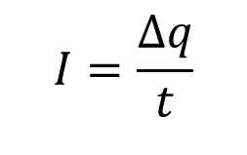
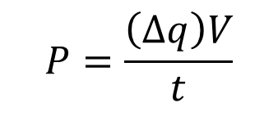

09-03 Electric Power and AC/DC
$$P=\frac{W}{t}$$
$$W=ΔEPE=\left(Δq\right)V$$
$$P=\frac{\left(Δq\right)V}{t}$$
$$I=\frac{Δq}{t}$$
$$P=IV$$

Slide 25
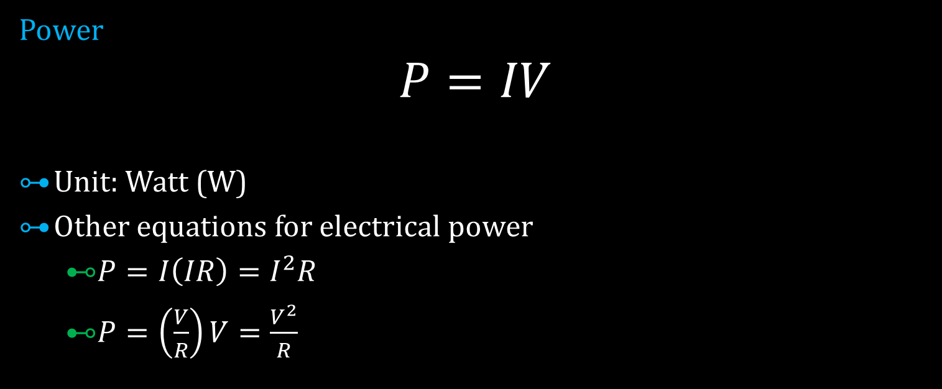
09-03 Electric Power and AC/DC
Power
$$P=IV$$
Unit: Watt (W)
Other equations for electrical power
  $P=I\left(IR\right)=I^{2}R$
  $P=\left(\frac{V}{R}\right)V=\frac{V^{2}}{R}$
Notes:
V=IR → I = V/R

Slide 26

09-03 Electric Power and AC/DC
Let’s say an electric heater has a resistance of 1430 $Ω$ and operates at 120V. What is the power rating of the heater? How much electrical energy does it use in 24 hours?
P = 10.1 W
E = 873 kJ
Notes:
Power
$$P=\frac{V^{2}}{R}=\frac{{\left(120 V\right)}^{2}}{1430 Ω}=10.1 W$$
Energy use
$$P=\frac{W}{t} → W=Pt=\left(10.1 W\right)\left(86400 s\right)=872640 J$$

Slide 27
09-03 Electric Power and AC/DC
Kilowatt hours
Electrical companies charge you for the amount of electrical energy you use
Measured in kilowatt hours (kWh)
If electricity costs $0.15 per kWh how much does it cost to operate the previous heater (P = 10.1 W) for one month?
$1.09
Notes:
$$E=\left(0.0101 kW\right)\left(720 h\right)=7.272 kWh$$
$$Cost=\left(7.272 kWh\right)\left(\$0.15\right)=\$1.09$$

Slide 28
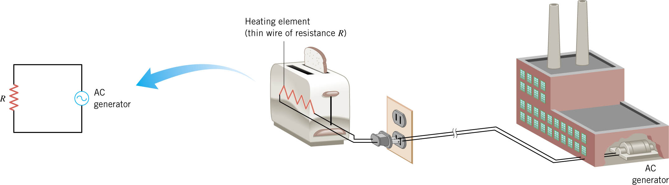
09-03 Electric Power and AC/DC
Alternating Current
Charge flow reverses direction periodically
Due to way that power plants generate power
Simple circuit

Slide 29
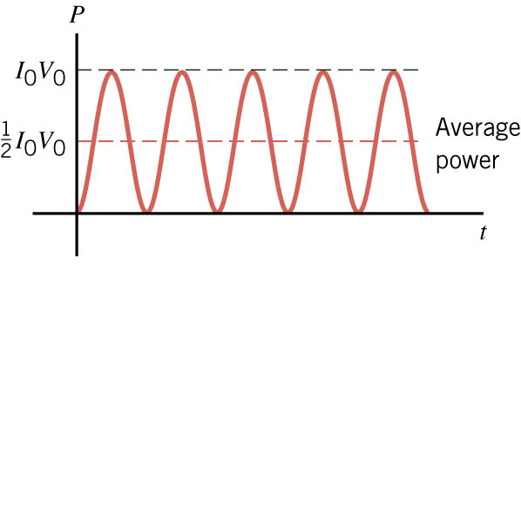
09-03 Electric Power and AC/DC
Periodicity
Voltage, Current, and Power fluctuate with time
So we usually talk about the averages

Slide 30
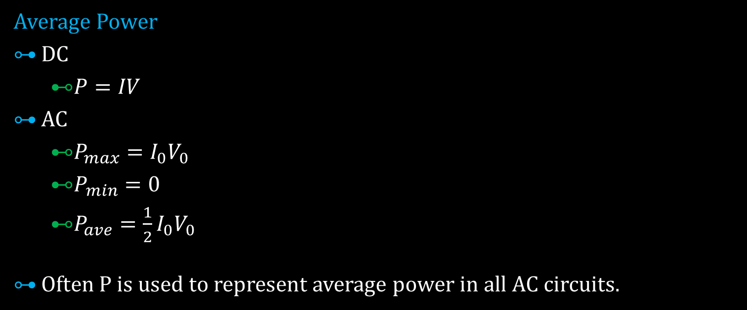
09-03 Electric Power and AC/DC
Average Power
DC
  $P=IV$
AC
  $P_{max}=I_{0}V_{0}$
  $P_{min}=0$
  $P_{ave}=\frac{1}{2}I_{0}V_{0}$
Often P is used to represent average power in all AC circuits.
Notes:
I₀ and V₀ stand for the maximum value

Slide 31
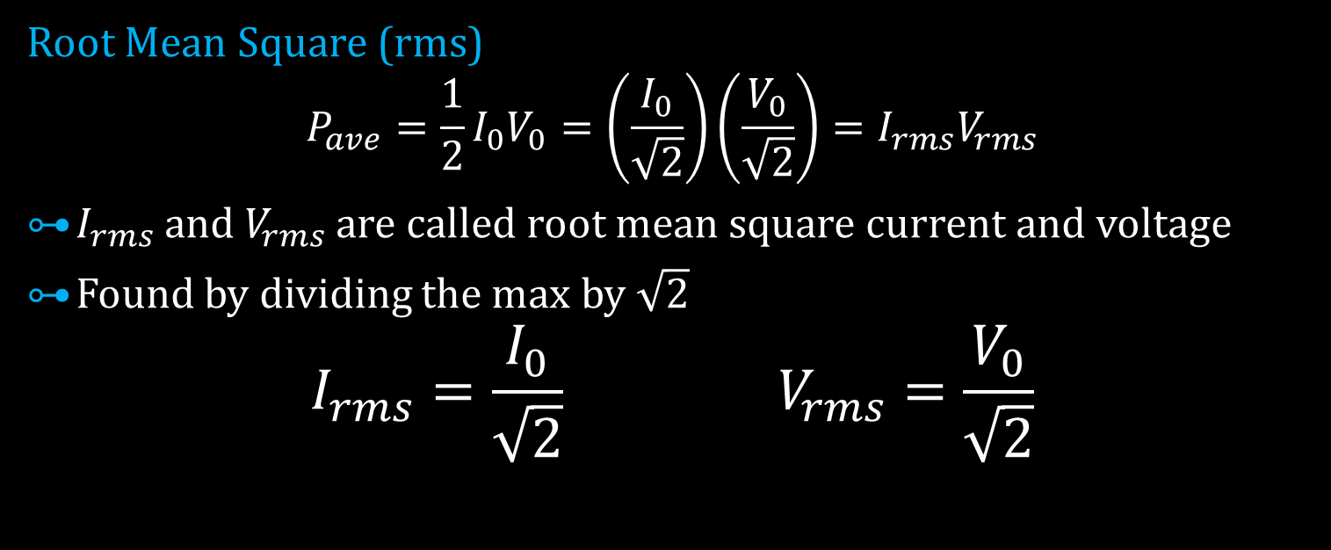
09-03 Electric Power and AC/DC
Root Mean Square (rms)
$$P_{ave}=\frac{1}{2}I_{0}V_{0}=\left(\frac{I_{0}}{\sqrt{2}}\right)\left(\frac{V_{0}}{\sqrt{2}}\right)=I_{rms}V_{rms}$$
$I_{rms}$ and $V_{rms}$ are called root mean square current and voltage
Found by dividing the max by $\sqrt{2}$
$$I_{rms}=\frac{I_{0}}{\sqrt{2}} V_{rms}=\frac{V_{0}}{\sqrt{2}}$$

Slide 32
09-03 Electric Power and AC/DC
Convention in USA
V₀ = 170 V
V_{rms} = 120 V
Most electronics specify 120 V, so they really mean V_{rms}
We will always (unless noted) use average power, and root mean square current and voltage
Thus all previously learned equations work!

Slide 33
09-03 Electric Power and AC/DC
A 60 W light bulb operates on a peak voltage of 156 V. Find the V_{rms}, I_{rms}, and resistance of the light bulb.
V_{rms} = 110 V
I_{rms} = 0.55 A
R = 202 Ω
Notes:
$$V_{rms}=\frac{156 V}{\sqrt{2}}=110 V$$
$$I_{rms}: P=IV→60 W=I\left(110 V\right)→I_{rms}=0.55 A$$
$$P=\frac{V^{2}}{R}→60 W=\frac{{\left(110 V\right)}^{2}}{R}→R=\frac{{\left(110 V\right)}^{2}}{60 W}→202 Ω$$

Slide 34
09-03 Electric Power and AC/DC
Why are you not supposed to use extension cords for devices that use a lot of power like electric heaters?
P = IV
  P is large so I is large
The wire has some resistance
The large current and little resistance can cause heating
If wire gets too hot, the plastic insulation melts
Notes:
Wire resistance varies directly with L and inversely with A
If you use an extension cord, use one with thick wires and short length to reduce resistance
Remember small gauge means big wires

Slide 35
09-03 Homework
Don’t write down just answers. Alternatively show your work, too.
Read 20.6, 20.7

Slide 36
09-04 Electricity and the Human Body
In this lesson you will…
• Define thermal hazard, shock hazard, and short circuit.
• Explain what effects various levels of current have on the human body.

Slide 37
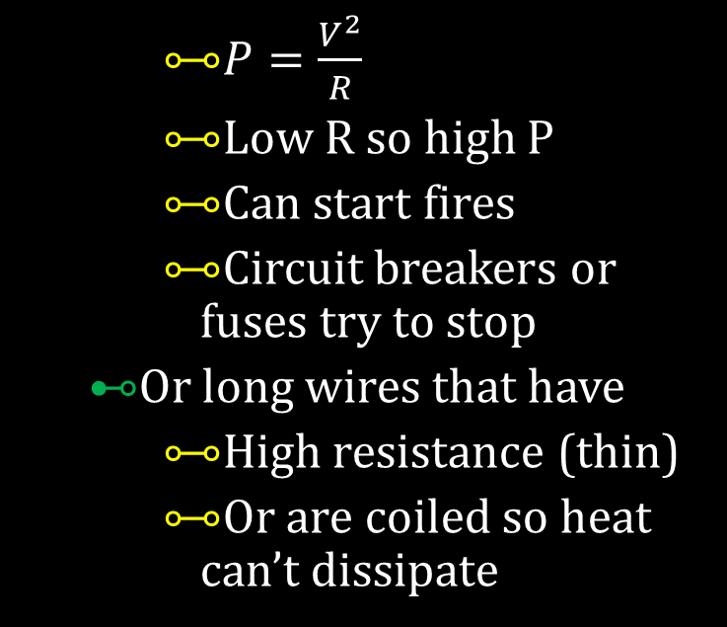
09-04 Electricity and the Human Body
Thermal Hazards
  Electric energy converted to thermal energy faster than can be dissipated
  Happens in short circuits
    Electricity jumps between two parts of circuits bypassing the main load
    $P=\frac{V^{2}}{R}$
    Low R so high P
    Can start fires
    Circuit breakers or fuses try to stop
  Or long wires that have
    High resistance (thin)
    Or are coiled so heat can’t dissipate
Notes:
Thin wires have higher R than thick wires
Heat can’t escape from coiled wires and they melt

Slide 38
09-04 Electricity and the Human Body
Shock Hazards
  Factors
    Amount of Current
    Path of current
    Duration of shock
    Frequency of current
Human body mainly water, so decent conductor
Muscles are controlled by electrical impulses in nerves
A shock can cause muscles to contract
  Cause fist to close around wire (muscles to close, stronger than to open)
Can cause heart to stop
Body most sensitive to 50-60 Hz

Slide 39
09-04 Homework
Don’t let these problems shock you.
Read 21.1

Slide 40
09-05 Resistors in Series and Parallel
In this lesson you will…
• Draw a circuit with resistors in parallel and in series.
• Calculate the voltage drop of a current across a resistor using Ohm’s law.
• Contrast the way total resistance is calculated for resistors in series and in parallel.
• Explain why total resistance of a parallel circuit is less than the smallest resistance of any of the resistors in that circuit.
• Calculate total resistance of a circuit that contains a mixture of resistors connected in series and in parallel.

Slide 41
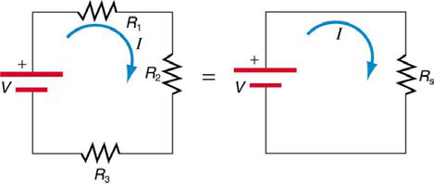
09-05 Resistors in Series and Parallel
Series Wiring
More than one device on circuit
Same current through each device
Break in device means no current
Form one “loop”
The resisters divide the voltage between them

Slide 42
09-05 Resistors in Series and Parallel
V divide among resistors
V = V₁ + V₂ + V₃
V = IR
V = IR₁ + IR₂ + IR₃
V = I(R₁ + R₂ +R₃)
V = IR_{S}
R_{S} = R₁ + R₂ + R₃ + …
Notes:
R_{s} is the equivalent resistance in Series

Slide 43
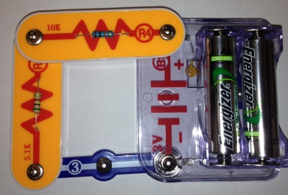
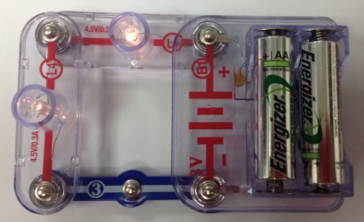
09-05 Resistors in Series and Parallel
A 5.17 kΩ resistor and a 10.09 kΩ resistor are connected in series. What is the equivalent resistance?
15.26 kΩ
Notes:
Circuit board and multimeter to measure
5.17 kΩ + 10.09 kΩ = 15.26 kΩ

Slide 44
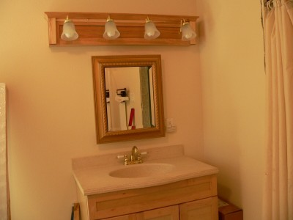
09-05 Resistors in Series and Parallel
Bathroom vanity lights are occasionally wired in series. V = 120 V and you install 3 bulbs with R = 8Ω and 1 bulb with R = 12Ω. What is the current, voltage of each bulb, and the total power used?
I = 3.33 A
V = 26.7 V, 40 V
P_{total} = 400 W
Notes:
$$R_{S}=3\left(8 Ω\right)+12 Ω=36 Ω$$
$$V=IR→120 V=I\left(36 Ω\right) → I=3.33 A$$
$$V=IR → V=\left(3.33 A\right)\left(8 Ω\right)=26.7 V$$
$$→ V=\left(3.33 A\right)\left(12 Ω\right)=40 V$$
$$P=I^{2}R → P={\left(3.33 A\right)}^{2}\left(8 Ω\right)=88.9 W$$
$$→ P={\left(3.33 A\right)}^{2}\left(12 Ω\right)=133.3 W$$
$$P_{total}=3\left(88.9 W\right)+133.3 W=400 W$$
$$→ P=I^{2}R={\left(3.33 A\right)}^{2}\left(36 Ω\right)=400 W$$
Notice you can total the power and the voltage

Slide 45
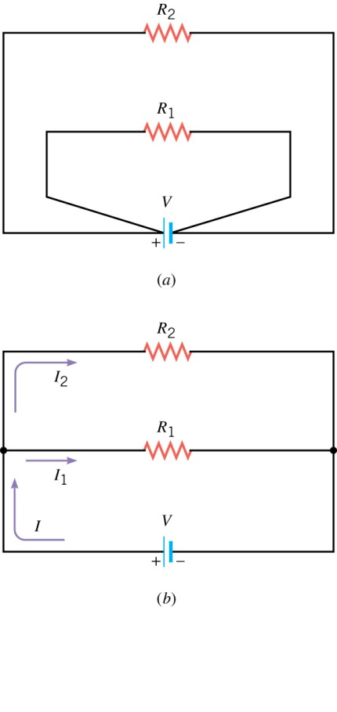
09-05 Resistors in Series and Parallel
Parallel Wiring
Same voltage across several devices
Typical house wiring
Break in device has no effect on current
Resistors divide current

Slide 46
09-05 Resistors in Series and Parallel
Derivation
Each branch draws current as if the other wasn’t there
Each branch draws less current than the power supply gives
R = V / I
Overall circuit: Large I → Small R
  Smaller resistance than either branch

Slide 47
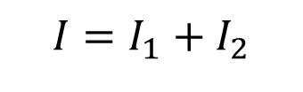

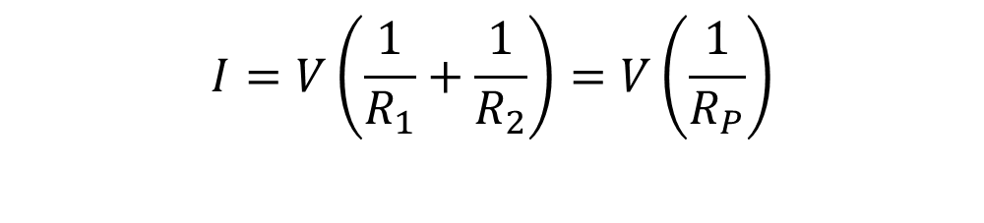
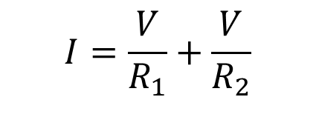
09-05 Resistors in Series and Parallel
$$I=I_{1}+I_{2}$$
$$I=\frac{V}{R}$$
$$I=\frac{V}{R_{1}}+\frac{V}{R_{2}}$$
$$I=V\left(\frac{1}{R_{1}}+\frac{1}{R_{2}}\right)=V\left(\frac{1}{R_{P}}\right)$$

Slide 48

09-05 Resistors in Series and Parallel
Parallel Resistors
$$\frac{1}{R_{P}}=\frac{1}{R_{1}}+\frac{1}{R_{2}}+\frac{1}{R_{3}}+⋯$$

Slide 49
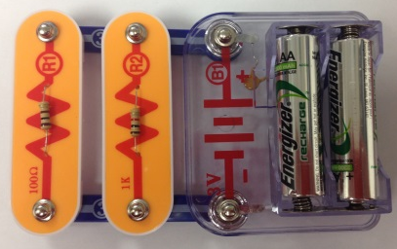
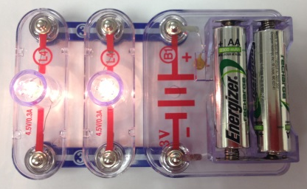
09-05 Resistors in Series and Parallel
A 1004 Ω resistor and a 101 Ω resistor are connected in parallel. What is the equivalent resistance?
91.8 Ω
If they were connected to a 3 V battery, how much total current would the battery supply?
32.7 mA
How much current through each resistor?
3.0 mA and 29.7 mA
Notes:
$$\frac{1}{R_{P}}=\frac{1}{R_{1}}+\frac{1}{R_{2}}$$
$$1/R_{P}=\frac{1}{1004 Ω}+\frac{1}{101 Ω}=0.000996/Ω+0.00990/Ω=0.010897/Ω$$
$$R_{P}=\frac{1}{0.010897/Ω}=91.8 Ω$$
$$V=IR→3 V=I\left(91.8 Ω\right) → I=0.0327 A=32.7 mA$$
$$V=IR → 3 V=I\left(1004 Ω\right) → I=0.0030 A$$
$$V=IR → 3 V=I\left(101 Ω\right) → I=0.0297 A$$
$$Add them together → 0.0327 A$$

Slide 50
09-05 Resistors in Series and Parallel
Circuits Wired Partially in Series and Partially in Parallel
Simplify any series portions of each branch
Simplify the parallel circuitry of the branches
If necessary simplify any remaining series

Slide 51
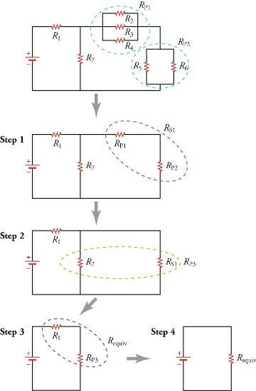
8-04 Circuits in Parallel and Series

Slide 52
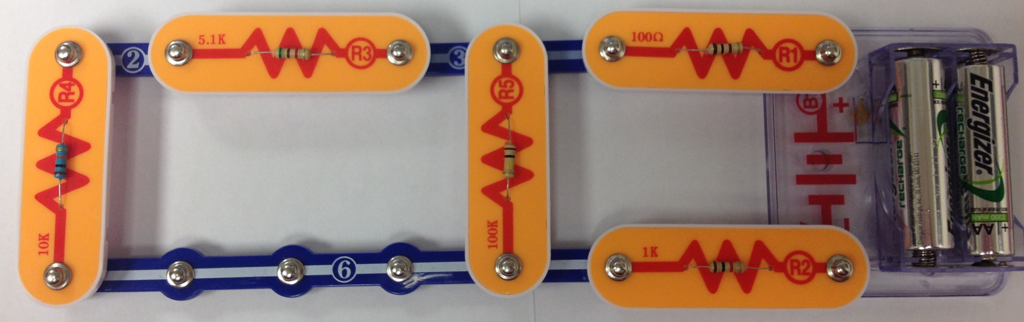
09-05 Resistors in Series and Parallel
Find the equivalent resistance and the total current of the following circuit.
5.17 kΩ
101 Ω
3 V
10.09 kΩ
100.9 kΩ
1004 Ω
101 Ω
5.17 kΩ
3 V
100.9 kΩ
10.09 kΩ
1004 Ω
Notes:
$$Combine far left branch \left(series\right)→10090 Ω +5170 Ω =15260 Ω$$
$$Combine left two branches \left(parallel\right)→\frac{1}{R}=\frac{1}{15260 Ω}+\frac{1}{100900 Ω}→\frac{1}{R}=7.54×{10}^{−5}\frac{}{Ω}→R=13255 Ω$$
$$The rest is series→13255 Ω+1004 Ω+101 Ω=14360 Ω$$
$$V=IR→3 V=I\left(14360 Ω\right)→I=2.09×{10}^{−4} A=209 mA$$

Slide 53
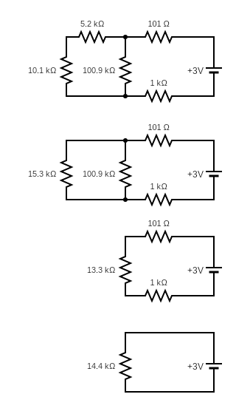
8-04 Circuits in Parallel and Series
Notes:
$$Combine far left branch \left(series\right)→10090 Ω +5170 Ω =15260 Ω$$
$$Combine left two branches \left(parallel\right)→\frac{1}{R}=\frac{1}{15260 Ω}+\frac{1}{100900 Ω}→\frac{1}{R}=7.54×{10}^{−5}\frac{}{Ω}→R=13255 Ω$$

Slide 54
8-04 Circuits in Parallel and Series
Notes:
$$The rest is series→13255 Ω+1004 Ω+101 Ω=14360 Ω$$
$$V=IR→3 V=I\left(14360 Ω\right)→I=2.09×{10}^{−4} A=209 mA$$

Slide 55
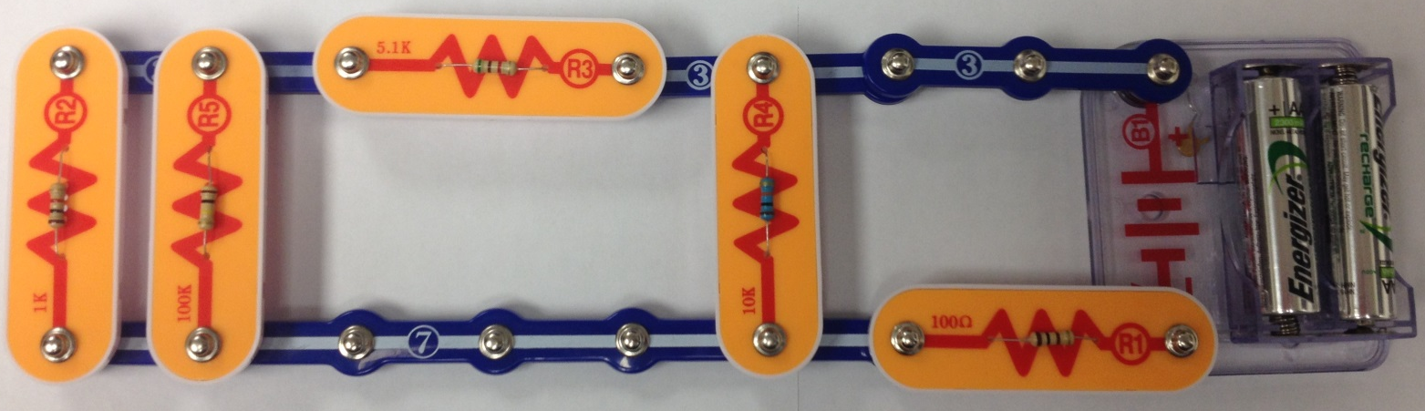
09-05 Resistors in Series and Parallel
Find the equivalent resistance.
5.17 kΩ
10.09 kΩ
3 V
100.9 kΩ
1004 Ω
101 Ω
2 Ω
1 Ω
20 Ω
1.5 V
5 Ω
4 Ω
15 Ω
3 Ω
2.5 Ω
Notes:
Far left two branches (parallel): $\frac{1}{R}=\frac{1}{1004 Ω}+\frac{1}{100900 Ω}→R=994.1 Ω$
Combine series: $R=994.1 Ω+5170 Ω=6164.1 Ω$
Combine parallel: $\frac{1}{R}=\frac{1}{6164.1 Ω}+\frac{1}{10090 Ω}→R=3826.5 Ω$
Combine series: $R=3826.5 Ω+101 Ω=3927 Ω$

Slide 56
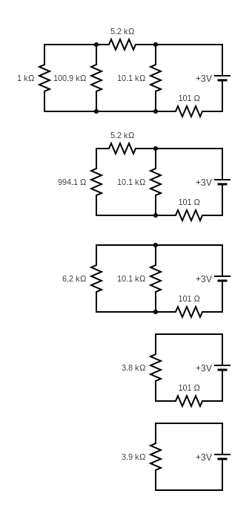
8-04 Circuits in Parallel and Series
Notes:
Far left two branches (parallel): $\frac{1}{R}=\frac{1}{1004 Ω}+\frac{1}{100900 Ω}→R=994.1 Ω$
Combine series: $R=994.1 Ω+5170 Ω=6164.1 Ω$

Slide 57
8-04 Circuits in Parallel and Series
Notes:
Combine parallel: $\frac{1}{R}=\frac{1}{6164.1 Ω}+\frac{1}{10090 Ω}→R=3826.5 Ω$
Combine series: $R=3826.5 Ω+101 Ω=3927 Ω$

Slide 58
09-05 Homework
These series of problems parallel the lesson.
Read 21.2

Slide 59
09-06 Electromotive Force: Terminal Voltage
In this lesson you will…
• Compare and contrast the voltage and the electromagnetic force of an electric power source.
• Describe what happens to the terminal voltage, current, and power delivered to a load as internal resistance of the voltage source increases (due to aging of batteries, for example).
• Explain why it is beneficial to use more than one voltage source connected in parallel.

Slide 60
09-06 Electromotive Force: Terminal Voltage
Emf
  Electromotive force
  Not really a force
  Really voltage produced that could drive a current

Slide 61
09-06 Electromotive Force: Terminal Voltage
Internal Resistance
Batteries and generators have resistance
In batteries → due to chemicals
In generators → due to wires and other components
Internal resistance is connected in series with the equivalent resistance of the circuit

Slide 62

09-06 Electromotive Force: Terminal Voltage
Internal resistance causes terminal voltage to drop below emf
Internal resistance is not necessarily negligible
$V=ℰ−Ir$
  $V=$ terminal voltage
  $ℰ=$ emf
  $I=$ current of circuit
  $r=$ internal resistance

Slide 63
09-06 Electromotive Force: Terminal Voltage
A string of 20 Christmas light are connected in series with a 3.0 V battery. Each light has a resistance of 10 Ω. The terminal voltage is measured as 2.0 V. What is the internal resistance of the battery?
100 Ω
Notes:
$$V=IR (circuit w/o battery)$$
$$2 V=I(20×10 Ω)→I=0.01 A$$
$$V=IR (internal resistance)$$
$$Voltage drop across internal resistance$$
$$3 V−2 V=1 V$$
$$1 V=\left(0.01 A\right)R→100 Ω=R$$

Slide 64
09-06 Electromotive Force: Terminal Voltage
A battery has an internal resistance of 0.02 Ω and an emf of 1.5 V. If the battery is connected with five 15 Ω light bulbs connected in parallel, what is the terminal voltage of the battery?
1.49 V
Notes:
Combine parallel circuits
$$\frac{1}{R}=5\left(\frac{1}{15 Ω}\right)→R=3 Ω$$
Combine with internal resistance
$$R=3.02 Ω$$
Find current draw
$$V=IR$$
$$1.5 V=I\left(3.02 Ω\right)→I=0.497 A$$
Use the circuit w/o battery to find terminal voltage
$$V=IR$$
$$V=\left(0.496 A\right)\left(3 Ω\right)=1.49 V$$

Slide 65
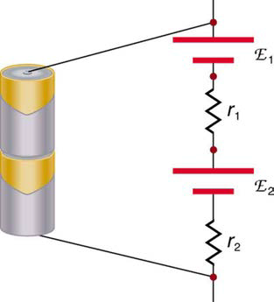
09-06 Electromotive Force: Terminal Voltage
If batteries are connected in series, their emfs add, but so do the internal resistances
If batteries are connected in parallel, their emfs stay the same, but the currents add and the combined internal resistance is less
Notes:
Think of resisters in series and parallel

Slide 66
09-06 Homework
Hard work takes lots of emf!
Read 21.3

Slide 67
09-07 Kirchhoff’s Rules
In this lesson you will…
• Analyze a complex circuit using Kirchhoff’s rules, using the conventions for determining the correct signs of various terms.

Slide 68

09-07 Kirchhoff’s Rules
Kirchhoff’s Rules
Junction Rule
  Total current into a junction must equal the total current out of a junction
Loop Rule
  For a closed-circuit loop, the total of all the potential rises $−$ total of all potential drops = 0
  (or the total voltage of a loop is zero)

Slide 69
09-07 Kirchhoff’s Rules
Reasoning Strategy
Draw the current in each branch of the circuit (flows out of positive terminal of battery). Choose any direction. If you are wrong you will get a negative current.
Mark each element with a plus and minus signs at opposite ends to show potential drop. (Current flows from + to – through a resistor)
  If the current leaves the element at +, voltage rise
  If the current leaves the element at -, voltage drop
Apply junction rule and loop rule to get as many independent equations as there are variables.
Solve the system of equations.

Slide 70
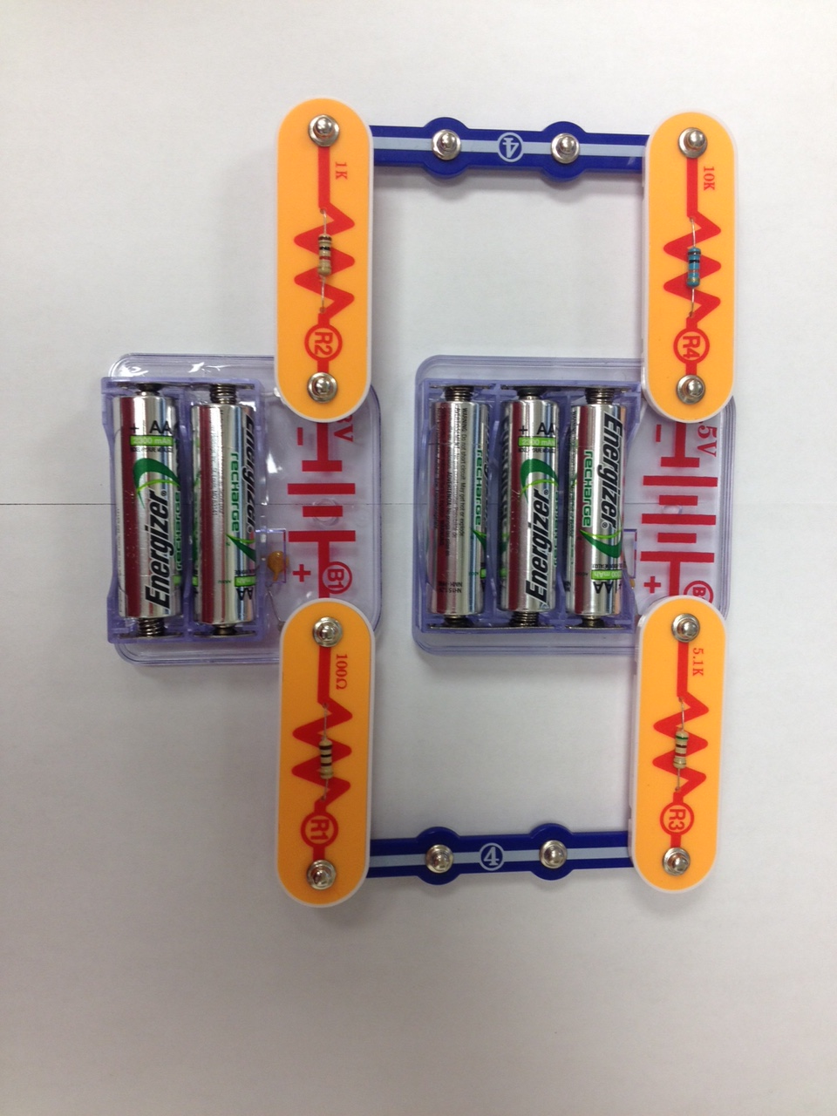
09-07 Kirchhoff’s Rules
Find the current through the circuit
10.09 kΩ
4.5 V
5.17 kΩ
3 V
101 Ω
1004 Ω
12V
5 Ω
3 Ω
I
8V
4 Ω
2 Ω
Notes:
Loop Rule (starting top left going CCW)
$$I\left(10090 Ω\right)+4.5 V+I\left(5170 Ω\right)+I\left(101 Ω\right)+I\left(1004 Ω\right)=3 V$$
$$16365 Ω I+4.5 V=3 V$$
$$16365 Ω I=−1.5 V$$
$$I=−9.17×{10}^{−5} A=91.7 μA$$

Slide 71
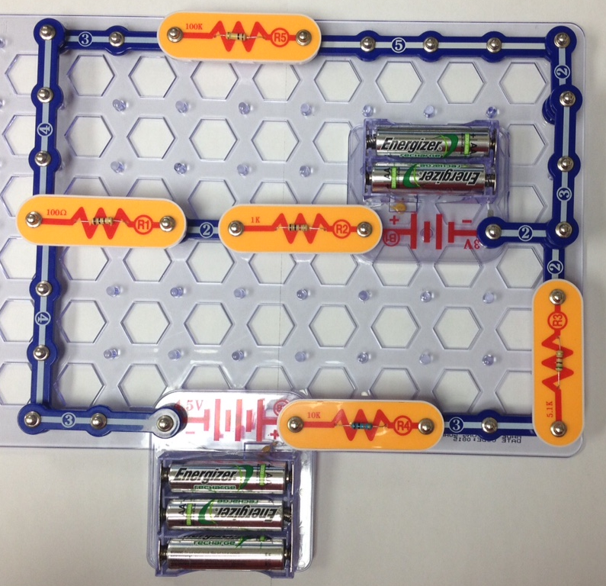
09-07 Kirchhoff’s Rules
Find the currents through each element.
100.9 kΩ
I₁
I₂
101 Ω
1004 Ω
3 V
I₃
5.17 kΩ
4.5 V
10.09 kΩ
30 Ω
I₁
45 V
40 Ω
1 Ω
I₃
20 Ω
I₂
80 V
1 Ω
Notes:
$$Left Junction: I_{3}=I_{1}+I_{2}$$
$$Top Loop CCW:3 V=\left(I_{2}\right)\left(1004 Ω\right)+\left(I_{2}\right)\left(101 Ω\right)−\left(I_{1}\right)\left(100900 Ω\right)$$
$$Bottom Loop CW: 4.5 V+3 V=\left(I_{3}\right)\left(10090 Ω\right)+\left(I_{3}\right)\left(5170 Ω\right)+\left(I_{2}\right)\left(1004 Ω\right)+\left(I_{2}\right)\left(101 Ω\right)$$
$$System$$
$$I_{1}+I_{2}−I_{3}=0$$
$$−100900 Ω\left(I_{1}\right)+1105 Ω\left(I_{2}\right)=3 V$$
$$1105 Ω\left(I_{2}\right)+15260 Ω\left(I_{3}\right)=7.5 V$$
$$I_{1}=−2.45×{10}^{−5} A, I_{2}=4.81×{10}^{−4} A, I_{3}=4.57×{10}^{−4} A$$

Slide 72
09-07 Homework
Currently, you need to work on these problems
Read 21.4

Slide 73
09-08 DC Voltmeters and Ammeters
In this lesson you will…
• Explain why a voltmeter must be connected in parallel with the circuit.
• Draw a diagram showing an ammeter correctly connected in a circuit.
• Describe how a galvanometer can be used as either a voltmeter or an ammeter.
• Find the resistance that must be placed in series with a galvanometer to allow it to be used as a voltmeter with a given reading.
• Explain why measuring the voltage or current in a circuit can never be exact.

Slide 74
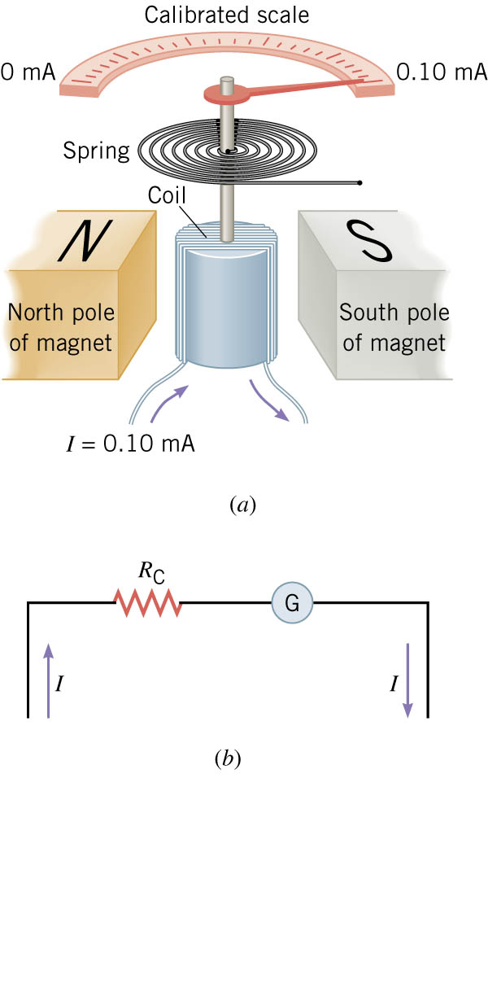
09-08 DC Voltmeters and Ammeters
Analog (non-digital) meters
Main component → galvanometer
Notes:
Made of magnets, wire coil, spring, pointer and calibrated scale.
Current flowing through the coil makes it magnetic, so it wants to move. The stronger the current the more the coil will rotate.

Slide 75
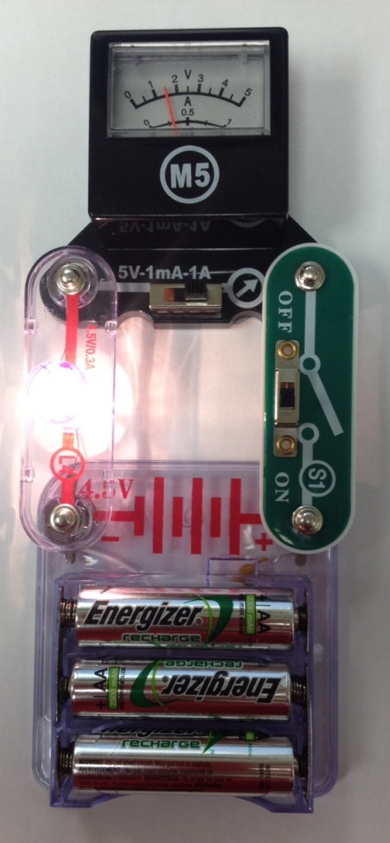
09-08 DC Voltmeters and Ammeters
Ammeters
  Measures current
  Inserted into circuit so current passes through it
    Connected in series

Slide 76
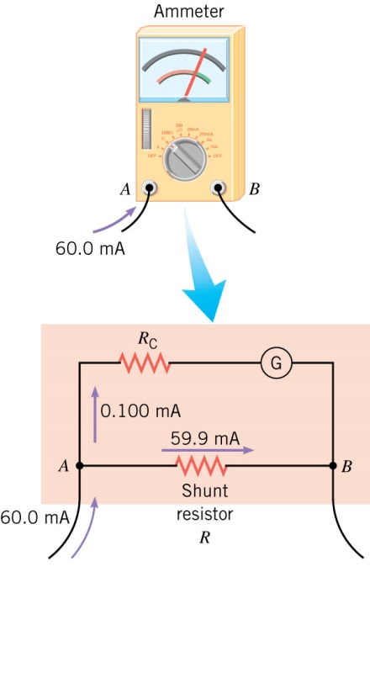
09-08 DC Voltmeters and Ammeters
Coil usually measures only little current
Has shunt resistors connected in parallel to galvanometer so excess current can bypass
  A knob lets you select which shunt resistor is used
Notes:
Example of Shunt resistors
Want to measure 100 mA, but meter’s coil only reads 0.100 mA.
Have shunt resistor take 99.9 mA and the coil only gets .1 mA
To know how big to make the shunt resistors, the resistance of the coil needs to be known.

Slide 77
09-08 DC Voltmeters and Ammeters
Problems with Ammeters
  The resistance of the coil and shunt resistors add to the resistance of the circuit
  This reduces the current in the circuit
  Ideal ammeter has no resistance
    Real-life good ammeters have small resistance so as only cause a negligible change in current

Slide 78
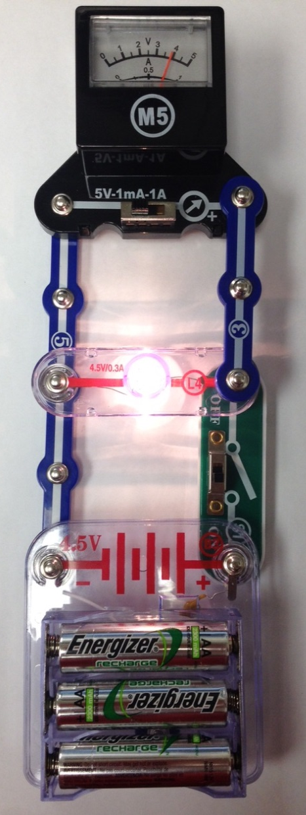
09-08 DC Voltmeters and Ammeters
Voltmeters
  Connected in parallel to circuit since parallel has same voltage
  The coil works just like in the ammeter
  Given the current and the resistance of the coil → V = IR
  To give more range, a large resistor is connected in series with the coil
Notes:
Large resistor is added because if V is constant Big R means small I

Slide 79
09-08 DC Voltmeters and Ammeters
Problems with Voltmeters
  The voltmeter takes some the voltage out of the circuit
  Ideal voltmeter would have infinitely large resistance as to draw tiny current
  Good voltmeter has large enough resistance as to make the current draw (and voltage drop) negligible

Slide 80
09-08 Homework
See if you measure up to these meter problems
Read 21.6

Slide 81
09-09 DC Circuits Containing Resistors and Capacitors
In this lesson you will…
• Explain the importance of the time constant, τ , and calculate the time constant for a given resistance and capacitance.
• Describe what happens to a graph of the voltage across a capacitor over time as it charges.
• Explain how a timing circuit works and list some applications.

Slide 82
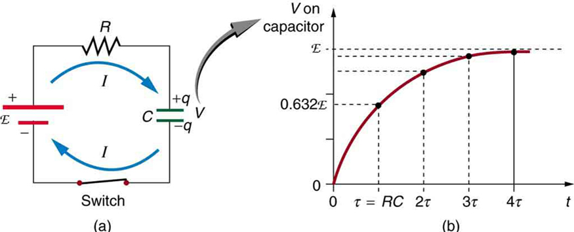
09-09 DC Circuits Containing Resistors and Capacitors
Charging a Capacitor
Circuit with a capacitor, battery, and resistor
Initially capacitor is uncharged
When battery connected current flows to charge capacitor
As charges build up, there is increased resistance because of the repulsion of the charges on the parallel plates
When capacitor is fully charged, no current will flow
Notes:
Current no longer flows because the parallel plates aren’t connected and it can’t accept anymore charge

Slide 83

09-09 DC Circuits Containing Resistors and Capacitors
Loop Rule
  $ℰ=\frac{q}{C}+IR$
Solve for I
  $I=\frac{V}{R}−\frac{q}{RC}$
I is rate of change of q
Differential Calculus says
Notes:
Draw the circuit with Battery, capacitor, and resistor

Slide 84


09-09 DC Circuits Containing Resistors and Capacitors
Charging a Capacitor
$q=CV\left(1−e^{−\frac{t}{RC}}\right)$
RC = τ (time constant – The time required to charge the capacitor to 63.2%)
CV = Q (maximum charge)
$V=ℰ\left(1−e^{−\frac{t}{RC}}\right)$
Where
  V is voltage across the capacitor
  $ℰ$ is emf
  t is time
  R is resistance of circuit
  C is capacitance

Slide 85


09-09 DC Circuits Containing Resistors and Capacitors
Discharging a Capacitor
The battery is disconnected
The capacitor acts like a battery supplying current to the circuit
Loop Rule
  $IR=\frac{q}{C}$
  $I=\frac{q}{RC}$
$q=Qe^{−\frac{t}{RC}}$
$V=V_{0}e^{−\frac{t}{RC}}$
Often capacitors are used to charge slowly, then discharge quickly like in camera flash.
Done by have different values for R in charging and discharging.

Slide 86
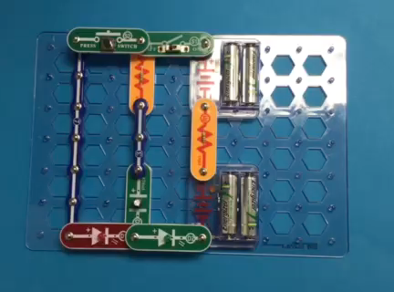
09-09 DC Circuits Containing Resistors and Capacitors
Camera flashes work by charging a capacitor with a battery.
  Usually has a large time constant because batteries cannot produce charge very fast
The capacitor is then discharged through the flashbulb circuit with a short time constant

Slide 87
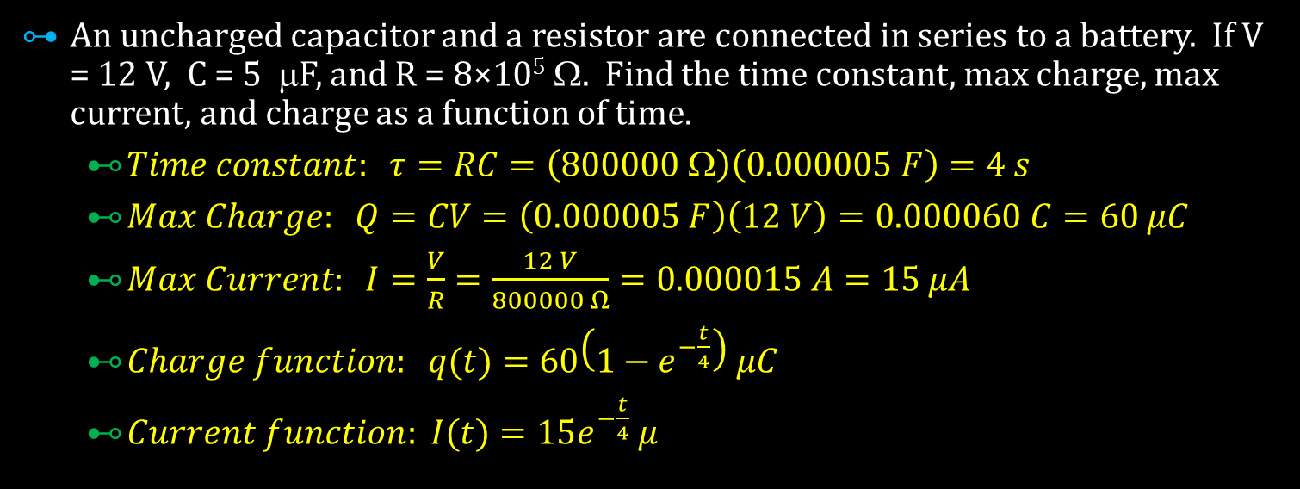
09-09 DC Circuits Containing Resistors and Capacitors
An uncharged capacitor and a resistor are connected in series to a battery. If V = 12 V, C = 5 μF, and R = 8×10⁵ Ω. Find the time constant, max charge, max current, and charge as a function of time.
  $Time constant: τ=RC=\left(800000 Ω\right)\left(0.000005 F\right)=4 s$
  $Max Charge: Q=CV=\left(0.000005 F\right)\left(12 V\right)=0.000060 C=60 μC$
  $Max Current: I=\frac{V}{R}=\frac{12 V}{800000 Ω}=0.000015 A=15 μA$
  $Charge function: q(t)=60\left(1−e^{−\frac{t}{4}}\right) μC$
  $Current function: I(t)=15e^{−\frac{t}{4}} μ$
Notes:
$$Time constant: τ=RC=\left(800000 Ω\right)\left(0.000005 F\right)=4 s$$
$$Max Charge: Q=CV=\left(0.000005 F\right)\left(12 V\right)=0.000060 C=60 μC$$
$$Max Current: I=\frac{V}{R}=\frac{12 V}{800000 Ω}=0.000015 A=15 μA$$
$$Charge function: q(t)=60\left(1−e^{−\frac{t}{4}}\right) μC$$
$$Current function: I(t)=15e^{−\frac{t}{4}} μA$$

Slide 88
09-09 Homework
Discharge your knowledge by completing these problems

